Slide 1



Predicting Community Readiness for
Substance Misuse Prevention based on a Survey of Community Partners
Christine Guerette, MS
UConn Health School of Medicine, Department of Public Health Sciences
The DMHAS Center for Prevention Evaluation and Statistics at UConn Health
CT Public Health Association (CPHA) 2024 Annual Conference
Building Healthier Communities Together: Centering on Community for Changemaking
November 18, 2024

Slide 2
Learning Objectives
1.
Describe which factors drive community readiness for substance misuse prevention.
2.
Recognize key elements of capacity that are relevant to a community’s readiness.
3.
Identify key areas where action can be taken to increase readiness for substance misuse prevention at a community level.

Slide 3
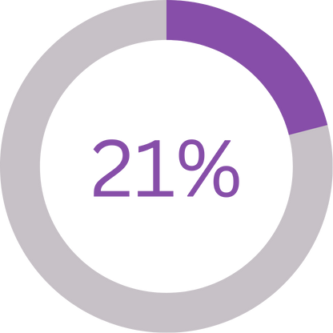
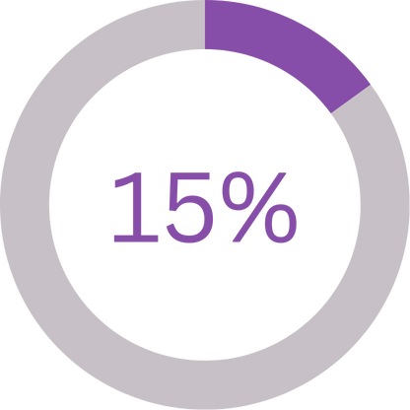
Adolescent Substance Use in Connecticut
of high school students reported current use* of alcohol
of high school students reported current use* of marijuana
*current use = used substance at least once in the past 30 days
Source: CSHS, 2023
Notes:
In the United States, alcohol and cannabis are the most commonly used substances among adolescents. In Connecticut, rates of alcohol (21%) and marijuana (15%) use among youth are similar to national estimates (Connecticut Department of Public Health, 2024). Initiation of substance use during adolescence has been linked to various adverse outcomes such as absenteeism, poor academic performance, depression, disengagement from peer groups, and increased risk for development of a substance use disorder (Centers for Disease Control and Prevention, 2024; Connolly et al., 2024). The prevalence of substance misuse among young people and the risks associated with it emphasize the need for targeted prevention efforts for adolescents. To address this issue effectively, the implementation of evidence-based prevention programming is imperative.

Slide 4
What is community readiness?
Community knowledge of the issue
Community concern
Data
Resources
Community
Readiness
Community culture/ climate
Community knowledge of efforts
Leadership
Notes:
Community readiness specifically, is the degree to which a community is willing and prepared to act on an issue, which impacts the likelihood that a prevention or intervention program will be successfully implemented (Chilenski et al., 2007). Community concern, available resources, community knowledge of efforts, leadership, community culture and climate, data, and community knowledge of the issue all play a role in how ready a community is to act on an issue.
LEARNING OBJECTIVE 1: Describe which factors drive community readiness for substance misuse prevention.

Slide 5
How Do We Measure Community Readiness?
Community Readiness Model (CRM)
  2nd edition developed by Oetting et al., 2014
Stage 9: Community ownership
Stage 8: Confirmation
Stage 7: Stabilization
Stage 6: Initiation
Stage 5: Preparation
Stage 4: Pre-planning
Stage 3: Vague awareness
Stage 2: Denial/ Resistance
Stage 1: No awareness
Notes:
The Community Readiness Model (CRM), designed by Oetting and colleagues (2014) can be used to measure how prepared communities are to address a given health issue. The CRM is based on the principle that communities exist at different stages of readiness and can increase their stage of readiness to develop and implement effective programs (Edwards et al, 2000). Note that a community’s readiness may also slide down the scale. The model identifies nine stages ranging from no awareness to high level of community ownership (Ogilvie et al., 2008). Community readiness stages evolve, such that prior ways of dealing with a problem or issue are superseded by more effective ways of thinking about and dealing with the same problem through the cultivation of new community-level competencies (Edwards et al., 2000).

Slide 6
Community Readiness Survey (CRS)
Statewide survey designed to assess CT’s readiness for substance misuse prevention at a community level
Developed using the Community Readiness Model (CRM)
  Partnership including the Department of Mental Health and Addiction Services (DMHAS), regional planning partners, the Connecticut Clearinghouse, and the UConn School of Medicine
Respondent pool: key informants* identified by Regional Behavioral Health Action Organizations (RBHAOs)
The CRM and its nine stages were used to select survey items discussed in the following presentation.
*key informant= someone who is knowledgeable about the issue of concern and the community
Notes:
The Community Readiness Survey (CRS) was developed using the Community Readiness Model by state partners, including the Department of Mental Health and Addiction Services (DMHAS), regional planning partners, the Connecticut Clearinghouse, and the UConn School of Medicine. The survey, completed by selected key informants, is designed to assess Connecticut’s community-level readiness and capacity to implement behavioral health prevention and promotion activities. This presentation limits its focus to survey items pertaining to substance misuse prevention for the most recent year it was administered (2022).
Including a question asking key informants to choose the readiness stage which best describes their community.

Slide 7
Methods – Sample
Data source: 2022 CRS
  All 169 CT towns & cities were represented in the survey
Majority of key informants (n = 1202)
  ages 36-65 (73.4%)
  female-identifying (71.5%)
  non-Hispanic (94.1%)
  White* (88.5%)
  represented suburban communities (43.4%)
  represented*
    schools (27.9%),
    parents (26.5%), and/or
    youth-serving organizations (22.9%)
*Race and sector are not comprised of mutually exclusive groups; respondents could select multiple options.
Notes:
Skim through slide – do not need to address all demographics

Slide 8
Methods – Measures
I think that most residents in this town/city...
Are concerned about preventing substance misuse.
Strongly agree
Strongly disagree
To what extent are the following elements barriers to or assets for alcohol and other drug prevention activities in the town/city?
Neither barrier nor an asset
A great barrier
A great asset
Availability of leadership.
How would you rate the town/city's current ability to undertake the following activities?
Collect data on the nature of local behavioral health problems.
None
Moderate
Very high
Notes:
Predictors were selected from these sets of survey items based on how the Community Readiness Model defines stages of readiness.
Community attitudes toward substance misuse prevention
Barriers and facilitators for substance misuse prevention
Town/community ability to implement prevention programming

Slide 9

Methods – Analysis
Three linear regression models predicting community readiness stage
  Community attitudes
  Barriers and facilitators
  Town/community ability
To account for multiple analyses (three models), the alpha level for regression analyses was set using a Bonferroni correction:
$$α=\frac{.05}{3}=.017$$
Statistical analyses were conducted using R and IBM Statistics SPSS version 29.
Notes:
Linear regression models were conducted to understand which items (FIND BETTER WORD) influenced community readiness the most. Three separate linear regression models were conducted predicting community readiness stage, each using a set of five items as independent variables or predictors: (a) community attitudes for substance misuse prevention, (b) barriers and facilitators for substance misuse prevention, and (c) town ability to implement prevention programming. To account for multiple analyses, alpha was set at .017 for regression analyses using a Bonferroni correction.
Pearson’s chi-squared tests were conducted to detect differences between the characteristics of the samples comprised in each of the three models.

Slide 10
















Community Readiness for Substance Misuse Prevention
Community Attitudes Model
What is actionable to move community readiness?
Knowledge about local prevention programs
Concern about prevention
Feeling that prevention is a good investment
Belief that prevention programs for youth are effective
Belief that alcohol and drug use is a private matter
Knowledge about local prevention programs
Barriers & Facilitators Model
Concern about prevention
Access to data
Political support
Community buy-in
Access to data
MEASURES OF COMMUNITY READINESS
PREDICTORS OF COMMUNITY READINESS
Financial resources
Volunteers from
the community
Political support
Raise community awareness
Town Ability Model
Raise community awareness
Collect data
Identify community members as a resource
Collect data
Allocate local funds
Secure support from local policy makers
$denotes p<.01$6
Notes:
All models were found to be statistically significant in predicting CR stage. Two predictors in each model were found to be significantly and positively associated with CR stage (at an alpha level of .017).
LEARNING OBJECTIVE 2: Recognize key elements of capacity that are relevant to your community’s readiness. (significant predictors)

Slide 11
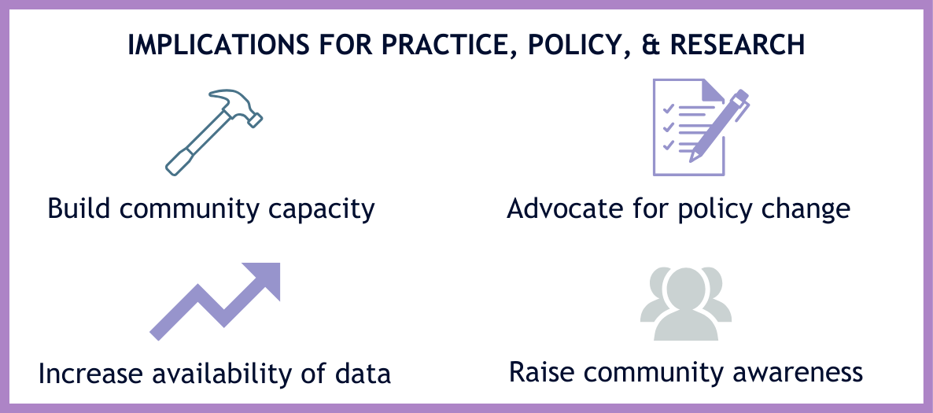
Discussion
Notes:
The six predictive factors identified from the models are closely connected in prevention practice.
Efforts to build capacity that focus on enhancing community ability to undertake prevention-relevant activities can help increase readiness and positively address the key community attitudes and barriers and facilitators associated with community readiness. Additionally, increasing community capacity to conduct the data collection and awareness-raising can bolster community concern and knowledge, increase the availability of relevant data, and ultimately increase political support for prevention.
LEARNING OBJECTIVE 3: Identify key areas where action can be taken to increase readiness for substance misuse prevention in your communities. (can take action by doing the four things in slide)

Slide 12
Considerations & Limitations
Samples for each model were different sizes because of missing responses
  However, respondent makeup was similar across models
Predictors for model were chosen based on theory (CRM)
Statistical results should be interpreted with caution due to violation of constant variance assumption
Actionable predictors may differ by community type
The Community Readiness Survey does not explicitly define “political support” and thus it may be interpreted in various ways by respondents
Notes:
The samples slightly differed for each model due to missing responses, which could account for differences seen in the results. A theoretical model was used to determine which survey items to choose for the models rather than statistical analysis such as model selection. Results should be interpreted with caution because a Breusch-Pagan test of the residuals from the town ability and barriers and facilitators models showed that the assumption of constant variance is violated (χ2 = 14.22, p = .014), (χ2 = 34.88, p < .001).
Additionally, while this study compared overall substance misuse prevention readiness across community types, drivers of these differences were not explored, and the community attitudes, abilities, and barriers/facilitators that correlated with readiness were not analyzed by community type.
Finally, political support was not defined in the survey and so could have been interpreted differently by respondents (e.g., political campaigns, local policy/laws, politicians in community, etc.). As a result, the nature of political support as a community-level driver of readiness cannot be fully understood.

Slide 13
Next Steps
What can you do with this information?
Further Research
Bring it back to your community!
  We hope that these results can help you identify where to focus resources to bolster community readiness.
Do these predictors differ by community type?
Are these predictors also actionable for community readiness for mental health promotion?
Notes:
The results of this research provide prevention professionals and community organizers with important insight into focus areas for local capacity building that can increase readiness in communities that most need it. Prevention efforts should focus on data collection, education, and outreach strategies that support a focus on priority issues and raise community awareness and concern, as well as knowledge of existing community efforts and programs addressing the issue.
Additional research can be done to explore these themes deeper. For example, do the predictors of community readiness I discussed today play the same role in every community type, or do other factors rise to the top? Are these predictors also actionable for community readiness for mental health promotion? More research is required before we can answer these questions.
(i.e., rural, suburban, urban periphery, urban core, wealthy)

Slide 14
Acknowledgements
Contributors:
  Alversia Wade, MPH
  Megan O’Grady, PhD
  Antoinette Thuillier, MPH
  Janice Vendetti, MPH, CPH
  Jennifer Sussman, MFA
The contributors would like to acknowledge the Connecticut Department of Mental Health and Addiction Services (DMHAS) for their support of the 2022 Community Readiness Survey (CRS), the main data source for this presentation. The contributors also extend their appreciation to the staff of the Regional Behavioral Health Action Organizations, DMHAS’ planning organizations, who conducted key informant selection and outreach for the 2022 CRS.

Slide 15
References
Centers for Disease Control and Prevention. (2024). Youth risk behavior survey data summary and trends report: 2013-2023. https://www.cdc.gov/yrbs/dstr/index.html
Chilenski, S. M., Greenberg, M. T., & Feinberg, M. E. (2007). Community readiness as a multidimensional construct. Journal of Community Psychology, 35(3), 347-365. https://doi.org/10.1002/jcop.20152
Connecticut Department of Public Health. (2024). 2023 Connecticut school health survey (CSHS) summary graphs. https://portal.ct.gov/-/media/dph/cshs/2023/2023cth-graphs_ctdph-suppression_redacted_for-public-release-clean07022024.pdf
Connolly, S., Govoni, T. D., Jiang, X., Terranella, A., Guy, G. P., Green, J. L., & Mikosz, C. (2024). Characteristics of Alcohol, Marijuana, and Other Drug Use Among Persons Aged 13–18 Years Being Assessed for Substance Use Disorder Treatment — United States, 2014–2022 (Morbidity and Mortality Weekly Report (MMWR). https://www.cdc.gov/mmwr/volumes/73/wr/mm7305a1.htm
Edwards, R. W., Jumper-Thurman, P., Plested, B. A., Oetting, E. R., & Swanson, L. (2000). Community readiness: Research to practice. Journal of Community Psychology, 28(3), 291-307. https://doi.org/10.1002/(SICI)1520-6629(200005)28:3<291::AID-JCOP5>3.0.CO;2-9
Oetting E.R., Plested, B.A., Edwards, R. W., Thurman, P. J., Kelly, K. J., & Beauvais, F. (2014). Community readiness for community change (L. R. Stanley, Ed. 2 ed.). Tri-Ethnic Center for Prevention Research.
Ogilvie, K.A., Moore, R.S., Ogilvie, D.C., Johnson, K.W., Collins, D.A., & Shamblen, S.R. (2008). Changing readiness to prevention the abuse of inhalants and other harmful legal products in Alaska. Journal of Community Health, 33, 248-258. https://link.springer.com/article/10.1007/s10900-008-9087-7#citeas

Slide 16
Thank you!
For more information on the information presented today, contact:
Christine Guerette, cguerette@uchc.edu

